Slide 1

TEMP-LOGISTICS : Detroit's Seasonal Strategy
Ashwini Awathe(h04121)
Dinesh Arasavalli(hm3731)
Sravanthi Lankalapalli (hp8500)

Slide 2
Introduction
The transportation and logistics sector is pivotal to the functioning of modern economies, yet it remains vulnerable to climate-induced disruptions.
Extreme weather conditions can greatly impact the operational efficiency and safety of logistics networks.
This project focuses on the development of a predictive model tailored to forecast extreme temperatures in Detroit, with the goal of reinforcing the resilience of logistics and transportation infrastructure.
Objectives:
Develop a predictive model using LSTM, GRU networks to forecast extreme temperatures in the upcoming month and analyze which model gave best.
Measures to enhance logistics efficiency, reducing disruption risks during peak summer and winter seasons.
Use forecast insights for strategic planning in transportation, improving resilience and cost management against climate variability.

Slide 3
Methodology
Data Collection | Gathered 20 years of historical temperature data from Detroit, focusing on the months with historical temperature extremes (January and July) from the sources Weather Underground and National Weather Service. Data is collected from below website: https://meteostat.net/en/
Data Analysis | The dataset is cleaned followed by conducting rigorous analysis of temperature patterns focusing on January and July.
Model Development | GRU, LSTM models are used for analyzing and forecasting time series data due to its ability to capture temporal dependencies. These model were utilized to predict daily temperature trends, taking advantage of its sophisticated architecture that processes data sequences effectively.
Validation | Tested the model's predictions against recent year's data to ensure accuracy and reliability in forecasting extreme weather impacts on logistics.
Impact Study | This study will focus on determining how improved temperature forecasts can lead to more efficient route planning, maintenance scheduling, and overall operational efficiency in logistics.

Slide 4
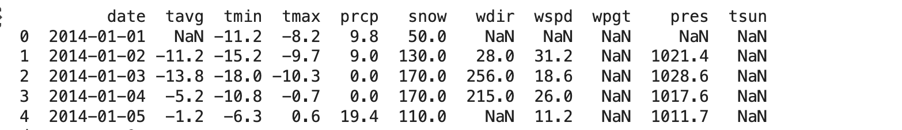
Data Pre-processing
Firstly, we checked for missing values in the dataset
Dropped the 'tsun' and 'wdir' columns as they are found to be not useful for our analysis.
Filled the missing 'tavg' values with the average of 'tmin' and 'tmax' and checked if there are any more missing values.
Found 52 more missing values for 'tavg' column and removed those rows.
Calculated the median values for 'prcp', 'snow', and 'wspd' and filled the missing values with these median.
Finally saved the resulting DataFrame to an Excel file.

Slide 5
Model Building- LSTM
The dataset 'Final.xlsx' is loaded into a DataFrame followed by convertion of 'date' to datetime format, and set it as the index.
Normalization is done on the loaded dataset using MinMaxScaler from to normalize average temperature data to a 0 to 1 range, ensuring uniform scale.
To prepare the temperature data for LSTM training, it is converted into sequences of 30 days, where each sequence forecasts the temperature of the next day.
After sequence creation, the data is reshaped into a three-dimensional format [samples, time steps, features], which is required for LSTM model input.
Using Keras, an LSTM model with a dense output layer and a single LSTM layer of fifty neurons is built. Using 90% of the data, the model is trained for 100 epochs with a batch size of 32 in order to minimize loss and adjust weights.
The trained model is used to make predictions on both the training set and the testing set. The predictions and the actual values are scaled back to their original temperature scale using the inverse of the MinMaxScaler to interpret the model’s performance in the same units as the original data.
To determine the accuracy and effectiveness of the predictions, the model is assessed using metrics Mean Squared Error (MSE), Root Mean Squared Error (RMSE), and R² Score.

Slide 6

Results
An MSE of 7.941 Indicates a moderate deviation between predicted and actual temperatures, with a small but significant average squared difference.
RMSE of 2.818 reflects that the model’s predictions deviate from actual temperatures by an average of 2.818 degrees, suggesting reasonable accuracy.
R² Score of 0.910 demonstrates that the model accounts for 91% of the variance in actual temperatures, highlighting its effective performance in capturing temperature variability.

Slide 7
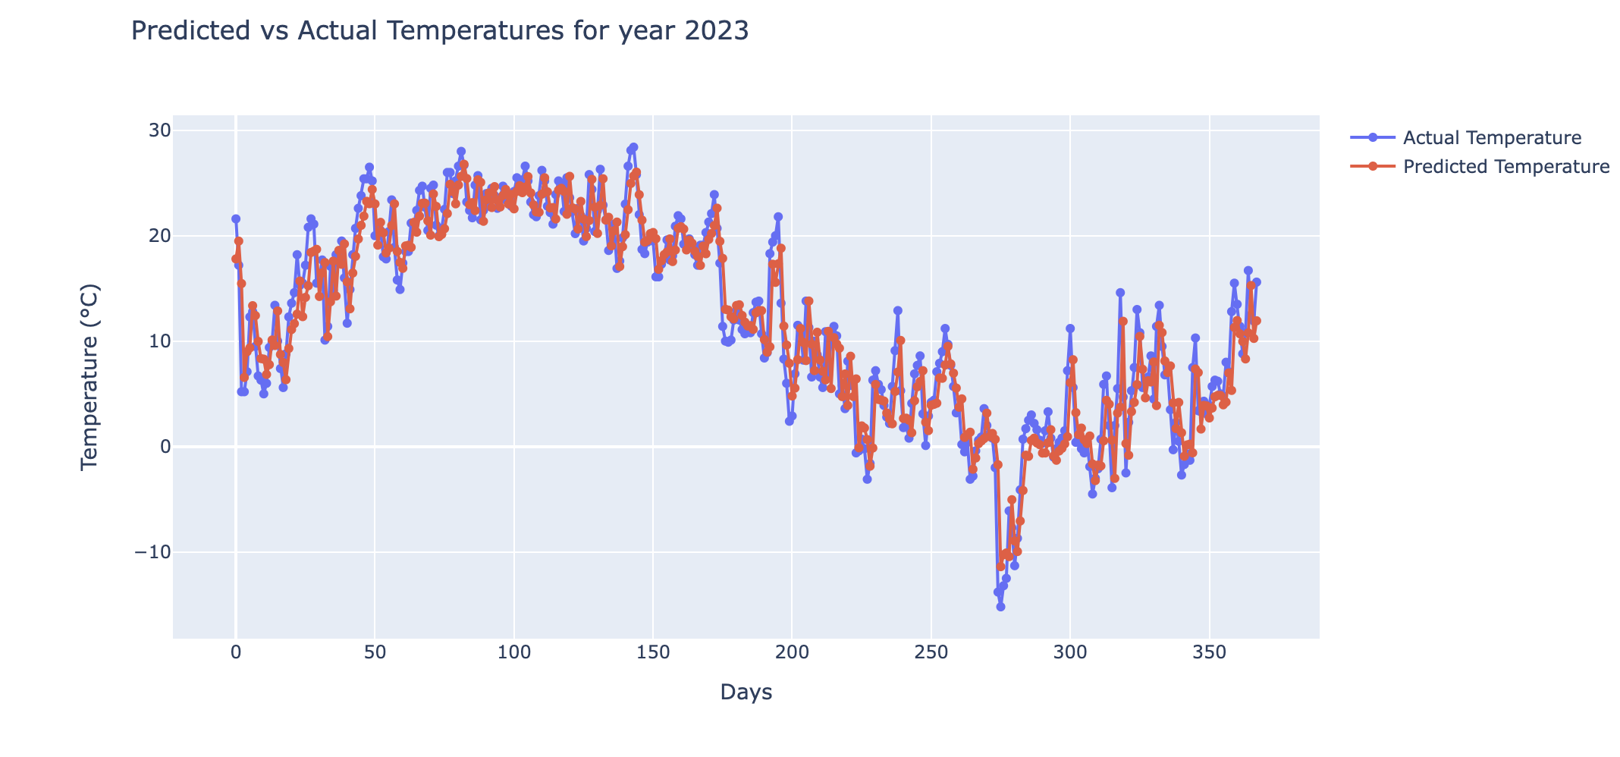
The graph represents a comparison between actual and predicted temperatures for the year 2023, illustrating a close alignment of the LSTM model’s outputs with real-world data.
It showcases the model's robustness in capturing seasonal temperature trends and fluctuations, indicating its reliability for practical forecasting applications.

Slide 8
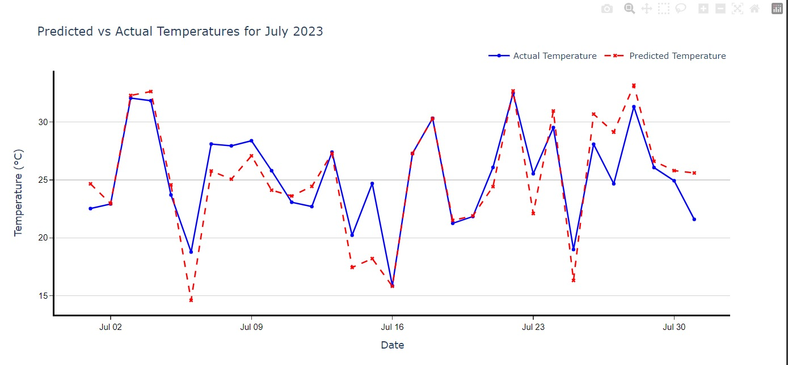
The graph shows the predictions of LSTM model for July 2023, closely following actual daily temperatures, indicating its effectiveness in short-term weather forecasting.

Slide 9
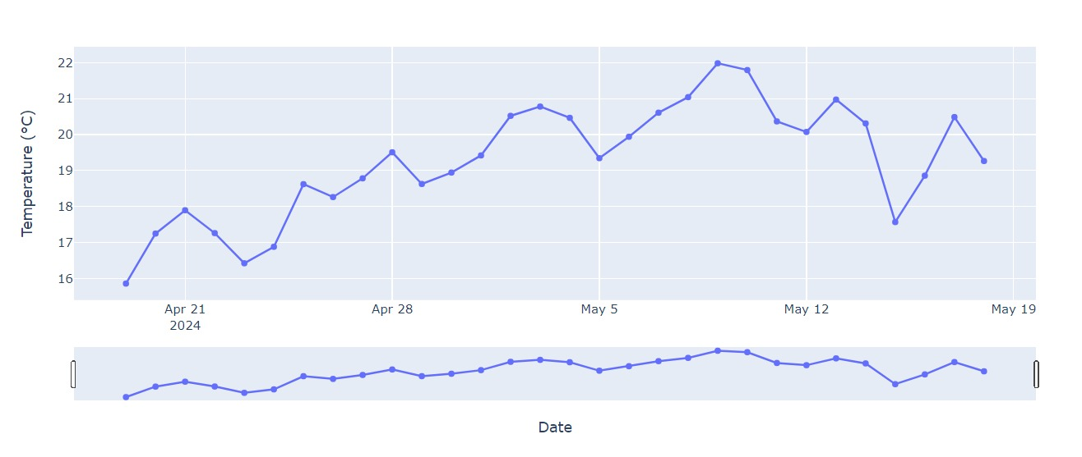
The graph displays a forecast of daily temperatures for the upcoming month May 2024, derived from LSTM model predictions based on the preceding month's data, highlighting the anticipated temperature trends.

Slide 10
GRU Model:
The model efficiently captures and analyzes temporal dependencies in temperature data by using two layers of 50-unit GRU units.
A 10% validation split is used in the model, which was trained for 30 epochs with a batch size of 32. This helps to monitor and prevent overfitting during the training phase.
Equipped with the Adam optimizer to effectively modify learning rates and employ mean squared error as the loss function for accurate prediction measurement.
Evaluation of post-training performance on a test set using the mean squared error (MSE) as a tool to measure and analyze the prediction error of the model.
Below are the resulting metrics of the model
Mean Squared Error: 0.002976089573092358
R2 Score: 0.9121856495398645

Slide 11
HOW CAN PREDICTING TEMPERATURES TRANSFORM LOGISTICS AND TRANSPORTATION?
Routing Efficiency: With roads modified for summer heat and winter ice, temperature forecasts help with strategic route planning to prevent weather delays.
Forecasting makes preventive vehicle maintenance possible, guaranteeing peak performance and security during seasonal temperature extremes.
Cargo Safety: From summer cooling to winter heating, anticipated temperature trends help maintain the integrity of delicate commodities.
Resource Optimization: By adjusting climate control to actual and anticipated conditions, weather insights lead to more economical energy use.

Slide 12
Thanks

